Slide 1
JARVIS
“ The virtual desktop AI Assistant chatbot ”
Project by..
Aditya M. Pattar & Sameer S. Khandeshe

Slide 2
Introduction
Virtual assistants are very useful for old generation people, people with disabilities or special cases, small children who don’t know to operate machines or smart gadgets, by making them sure that their interaction with machine is not difficult anymore and also enable them to perform Multitasking.
Basics fundamental tasks performed by Voice assistants are as follows:
Search on web
Play a music or video
Setting a reminder and alarm
Run any program or application
Getting weather updates

Slide 3
Need of voice assistants
To enable a highly engaging user experience:
Voice assistance engages users like no other interface. Users can speak to the applications naturally to asks for whatever they’d like.
To make application frustration free:
We have to touch, type and mouse in the existing machine system to getting our work done, which are makes user frustrated sometimes. By using voice assistant users can directly ask what they wanted to get done.
To personalize your app experience for every user:
Voice assistants are actually able to respond for every user based on their locality, language and preferences.
To Remove Language Barriers:
Voice Assistant technology are blended with Translation services which helps users to handle them in their own language without concerning about language barriers which allows them to interact more freely with voice assistant.

Slide 4
HARDWARE AND SOFTWARE REQUIREMENTS
Hardware Specification
Pentium-pro processor or later
RAM 8 GB or more.
Software Specification
Windows 10(64-bit) or above.
Python 3.11.1 or later
Chrome Driver
VS- Code
PyCharm IDE

Slide 5
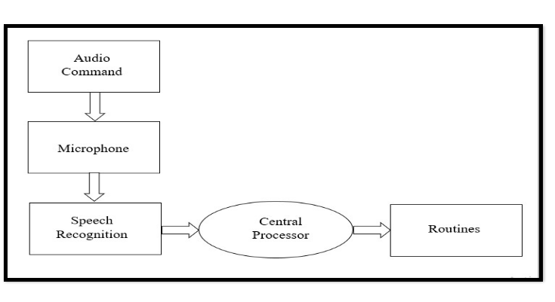
Existing System

Slide 6
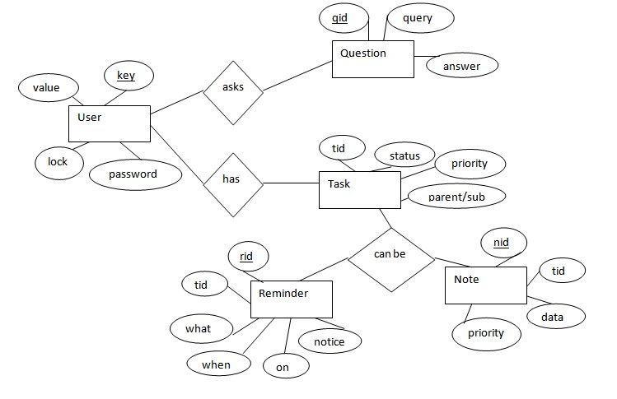
ER DIAGRAM

Slide 7
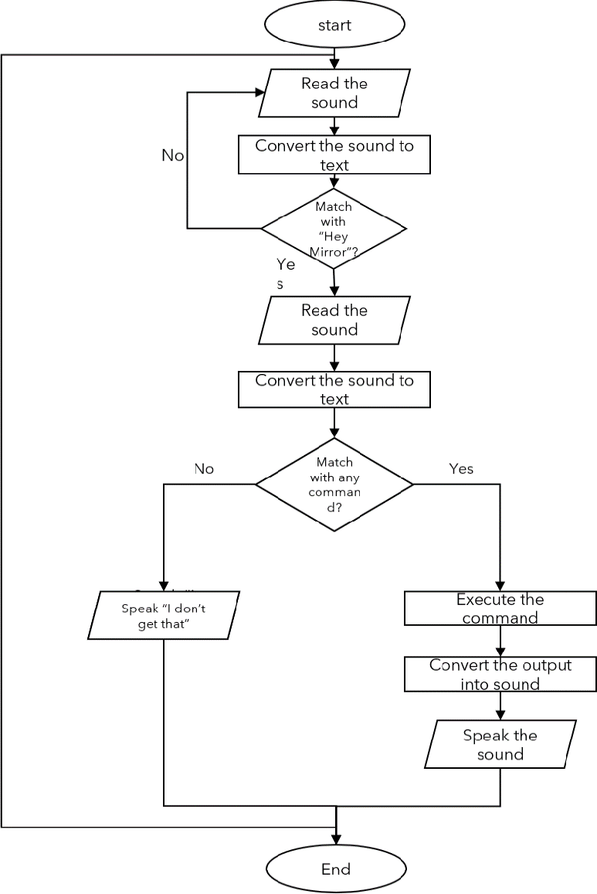
Sequential Data Flow Diagram

Slide 8
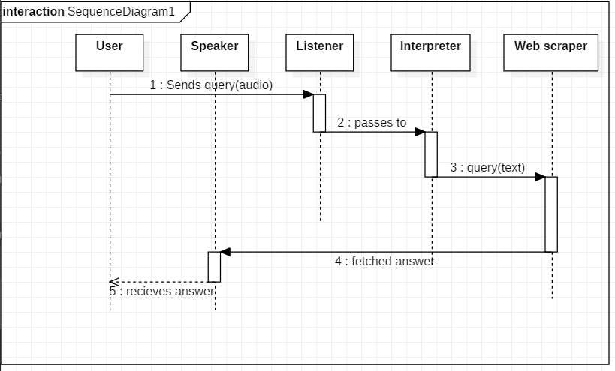
SEQUENCE DIAGRAM Sequence diagram for Query-Response

Slide 9
REAL LIFE APPLICATION
Saves time
Conversational interaction
Reactive nature
Multitasking
Virtual chatbot
Virtual assistantship

Slide 10
FUNCTIONALITY
TakeCommand (): The function is used to take the command as input through microphone of user and returns the output as string.
WishMe (): This function greets the user according to the time like Good Morning, Good Afternoon and Good Evening.
taskExecution(): This is the function which contains all the necessary task execution definition like sendEmail(), pdf_reader(), news() and many conditions in if condition like “open google”, “open notepad”, “search on Wikipedia” ,”play music” and “open command prompt” etc.

Slide 11
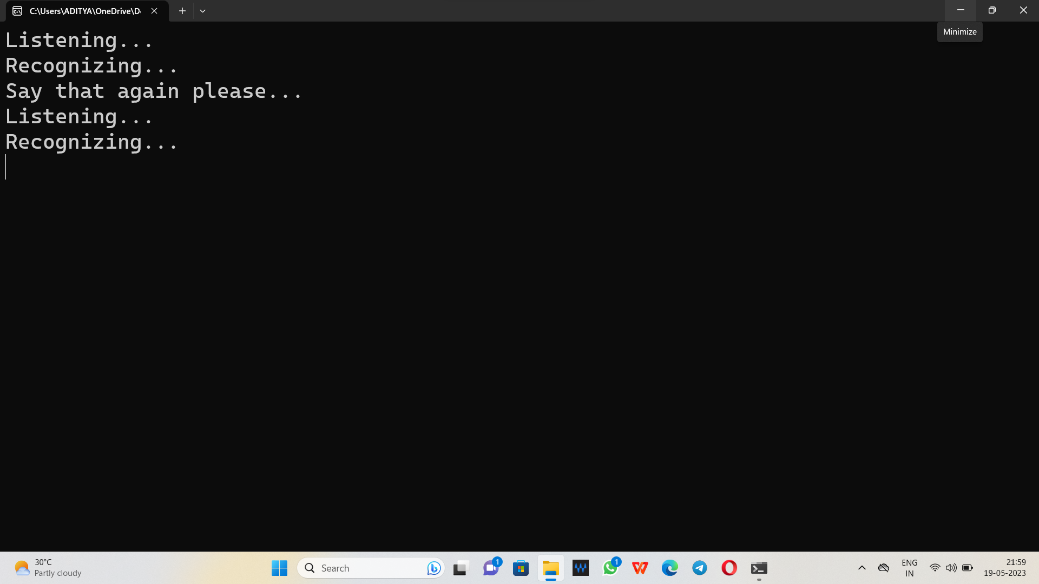
Virtual testing of Assistant
Jarvis.. on Listening and Recognizing mode

Slide 12
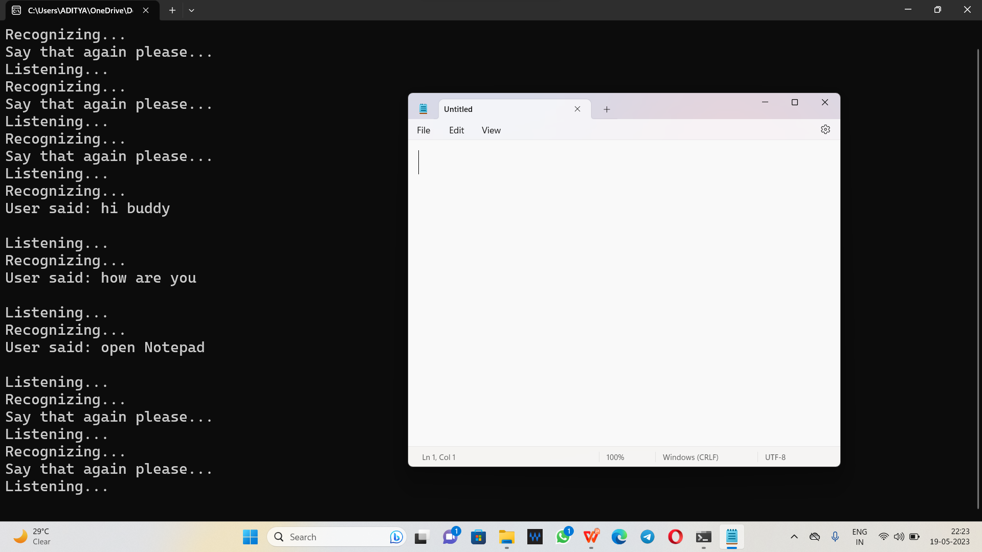
User Command: Open NotePad

Slide 13
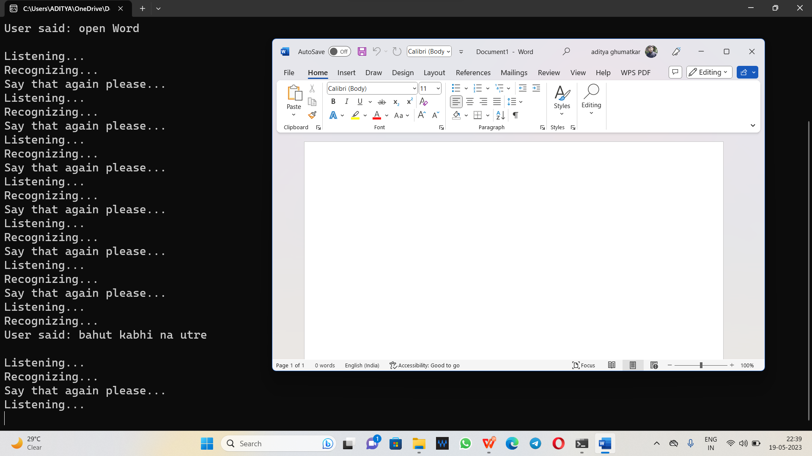
user Command: Open Word

Slide 14
CONCLUSION
In this Paper we have discussed uses, methodology as well as implementation details of the personal Desktop based voice assistant using Python which is built using open-source software PyCharm as an implementation tool. This Project will be helpful for people of all generations as well as to people with some disabilities or people with some special cases. The personal voice assistant will be easy to use and will reduce the manual human efforts for performing various tasks. The functionality of the current voice assistant system is limited to working on Desktop based and working online (required to have internet connection to perform tasks) only. The voice assistant system is modular in nature so that addition of new features is possible without disturbing current system functionalities.

